Slide 1
Natalie M. LaPrade Maryland Medical Cannabis Commission
National Association of Unemployment Appeals Professionals (NAUIAP)
June 20, 2018
Joy A. Strand, MHA
Executive Director

Slide 2
MMCC Core Competencies
Licensing – ensuring that growers, processors, dispensaries, and independent-testing lab facilities are in compliance with COMAR 10.62
Registration – oversee the process or adding patients, caregivers, and providers to participate in the program.
Compliance – team of inspectors ensures that facilities are adhering to the safety and security measures before initiating sales and during the operational stage.
Safety & Quality – Commission and ITLs work together to test product for potency and purity, stability, contaminants, the product’s cannabinoid profile, and other measures that provide consumer safety and confidence.

Slide 3
Legislative History

Slide 4
Legislative Timeline
2011 GA enacts Protection for use of medical cannabis for patients and recommending physicians
2012 3 bills introduced for medical cannabis. All 3 fail but set the precedent for 2013 legislative victories
2013 The GA created the MMCC for investigational use of medical cannabis
2013 Law expanded to include caregiver protection
2014 Legislation expands MMCC role to register physicians and conduct research for medicinal use cannabis
2011
2012
2013
2013
2014
2015
2015
2016
2017
2017
2015 Authorizes MMCC to license growers, processors, register ITL’s and inspect facilities
2015 MMCC receives high volume of applications
2016 Dentists, podiatrists and certified nurse midwives added to certified providers
2017 Prohibition of cannabis use in public
2017 December 1st product became available and on the shelves for Maryland patients

Slide 5
December 1st, 2017
Product becomes available for
Maryland certified patients

Slide 6
Commission Composition
Chairman – Brian Lopez
Executive Director – Joy A. Strand, MHA Deputy Director – Lori M. Dodson, M.S. MT(ASCP)
Commissioners = 16
12.1.17 Staff = 19
6.15.18 Staff = 38

Slide 7
Qualified Patient, Certifying Provider or Caregiver

Slide 8
Patient & Caregiver Registration
Online registration – mmcc.Maryland.gov
Upload personal information and recent photo
MMCC issues unique identifier via email
Patient designates caregiver upon registration
Patient visits certifying provider who writes recommendation for patient via website
Patient may then purchase cannabis from Maryland licensed dispensary

Slide 9
Provider Registration
Be a licensed provider in good standing in Maryland
Physician, NP, Cert. Nurse Mid-Wife, Podiatrist, Dentist
Online registration – mmcc.Maryland.gov
Renew registration every two (2) years
Specify conditions they will or will not certify for

Slide 10
Qualifying Medical Conditions
Severe or persistent muscle spams
Glaucoma
Post Traumatic Stress Disorder (PTSD)
Any condition which is severe and for which other medical treatments have been ineffective
Cachexia
Anorexia
Wasting syndrome
Severe or chronic pain
Severe nausea
Seizures

Slide 11
Maryland Patient Conditions
Data as of May 22, 2018

Slide 12
Limits on Medical Cannabis
Patients limited to a combination of 120 grams of flower or 36 grams of THC in a 30 day period
Certifications that are not used to obtain medical cannabis within 120 days of issuance become null and void.
Patient may only have 1 provider and 1 written recommendation at a time
Patient must renew certification by visiting a provider once per 365 days.

Slide 13
Patient/Provider Statistics

Slide 14
Statewide Cannabis Patient Statistics 6.18.18
Registered Patients 44,241
Certified Patients 30,584
Registered Minor Patients 167
Registered Hospice Patients 163
Registered Caregivers 2,539
Pending Caregiver 437
Registered Providers 929

Slide 15
Industry Categories
Grower – 14 licensed
Processor – 14 licensed
Dispensary – 50 licensed (> 50 pending)
Independent Testing Laboratory (ITL) - 5

Slide 16
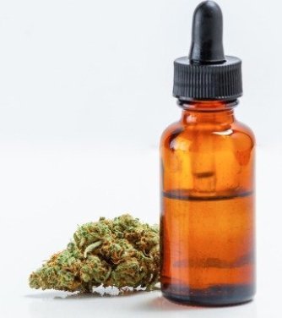
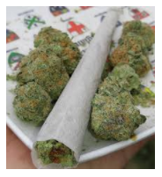
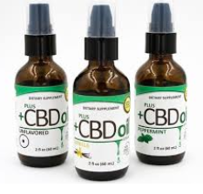
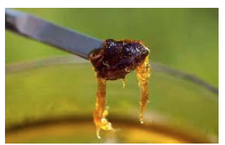
Medical Cannabis Products in MD
Flower/ Pre-rolls
Extracts, Oils, & Tinctures
Vape Cartridges
Capsules & Patches
Salves, Lotions, Ointments
Cannabis- infused edible food products ARE NOT approved in Maryland
Pre-rolls
Tinctures
Extracts
Oils

Slide 17
Purpose of METRC Software: Public Health and Public Safety
Metrc™ is a compliance management solution used by regulatory bodies for the oversight of the cannabis industry.
Metrc is a cloud hosted on-line software tracking & reporting system.
MD licensed medical cannabis businesses are required to track and report supply chain activities from ‘seed to sale’.
https://www.metrc.com

Slide 18
METRC™
Total tracking of cannabis; immature plant finalized product sale
Integrated with MMCC Registry to track the amount of medical cannabis per patient
Facility reports – transfers, transactions, testing procedures per facility
Testing results recorded in Metrc
Control product recall by placing administrative holds
Real-time transaction oversight
Industry must document activity in METRC for state regulatory purposes

Slide 19
Maryland Medical Cannabis Sales Dec 2017 – May 2018
Flower (pounds) 2,570
Infused Products (each) 202,611
Transactions 532,408
Sales in $$ $ 27,926,422

Slide 20
Any Questions? joystrand@Maryland.gov 410.487.8050
Note: The information presented here are for informational purposes only and not for the purpose of providing legal advice. You should contact your attorney to obtain advice with respect to any particular issue or problem.

