Slide 1
State Self-Assessment - Appeals
Candace Edens
Chief, Federal and State Programs
Office of Unemployment Insurance
USDOL/ETA
June 19, 2018

Slide 2
The State Self-Assessment:
Examines key areas of agency’s UI program and identifies areas where improvement is needed and areas where the state excels in its operations
Is intended to be used by the state’s UI administrators/managers to identify areas where improvements are needed and to formulate a strategy to mitigate any issues
Will allow the state to take any needed corrective action, as appropriate, and as soon as feasible, and will allow ETA to determine states that may be in need of heightened technical assistance
Assists ETA in conducting monitoring and technical assistance visits in States (gives a baseline for performance)

Slide 3
WorkforceGPS Houses All State Self-Assessment Tools:
State Self-Assessment Orientation–Three Orientation Sessions
Recorded Quarterly Touch-Base Webinars
All guidance issued related to the State Self-Assessment
Other tools to help states with the Self-Assessment process
URL for UI Community of Practice (UICoP) Featured Resources: https://ui.workforcegps.org/

Slide 4
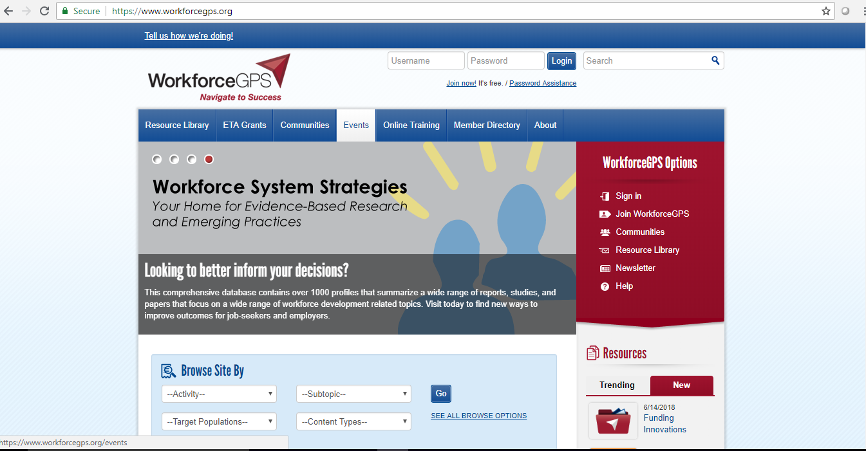
Navigating through WorkforceGPS

Slide 5
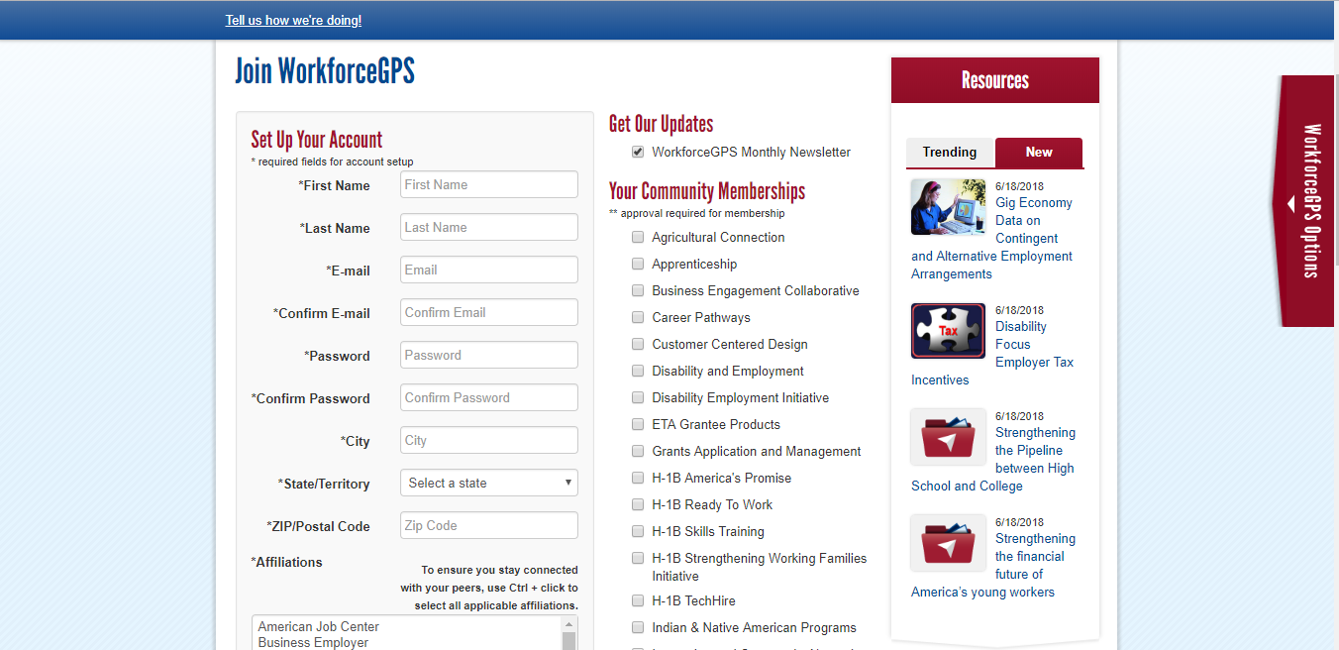
Complete the Account Set-up to Join WorkforceGPS

Slide 6
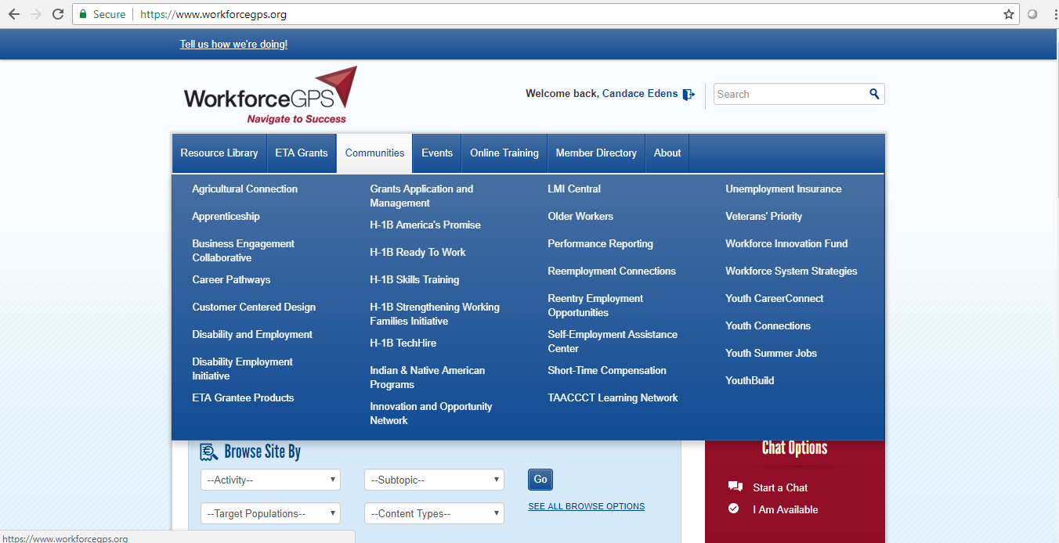
Navigating through WorkforceGPS

Slide 7
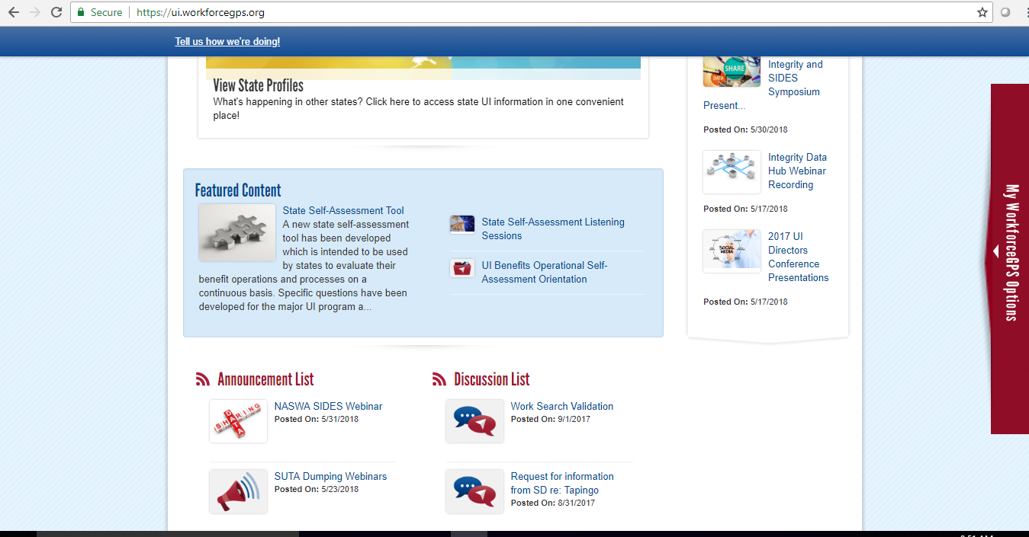
Finding the State Self-Assessment Tool and Other Resources

Slide 8
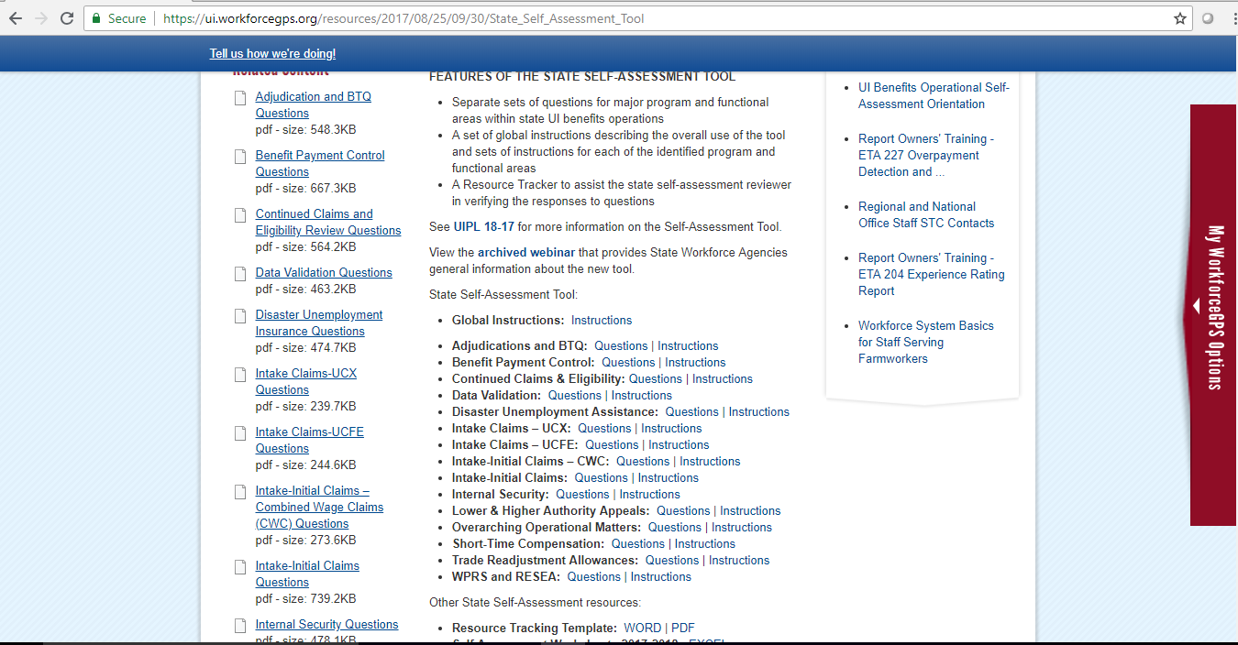
Finding the State Self-Assessment Tool for Appeals

Slide 9
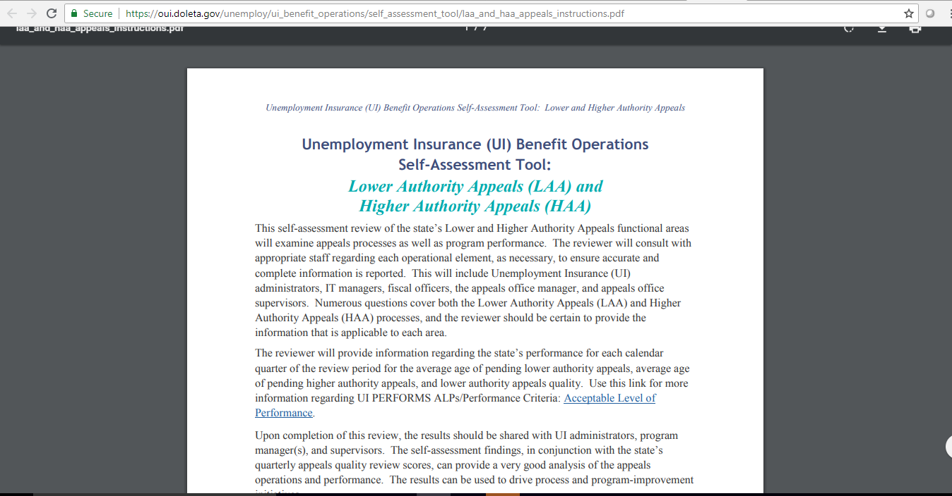
State Self-Assessment
Instructions

Slide 10
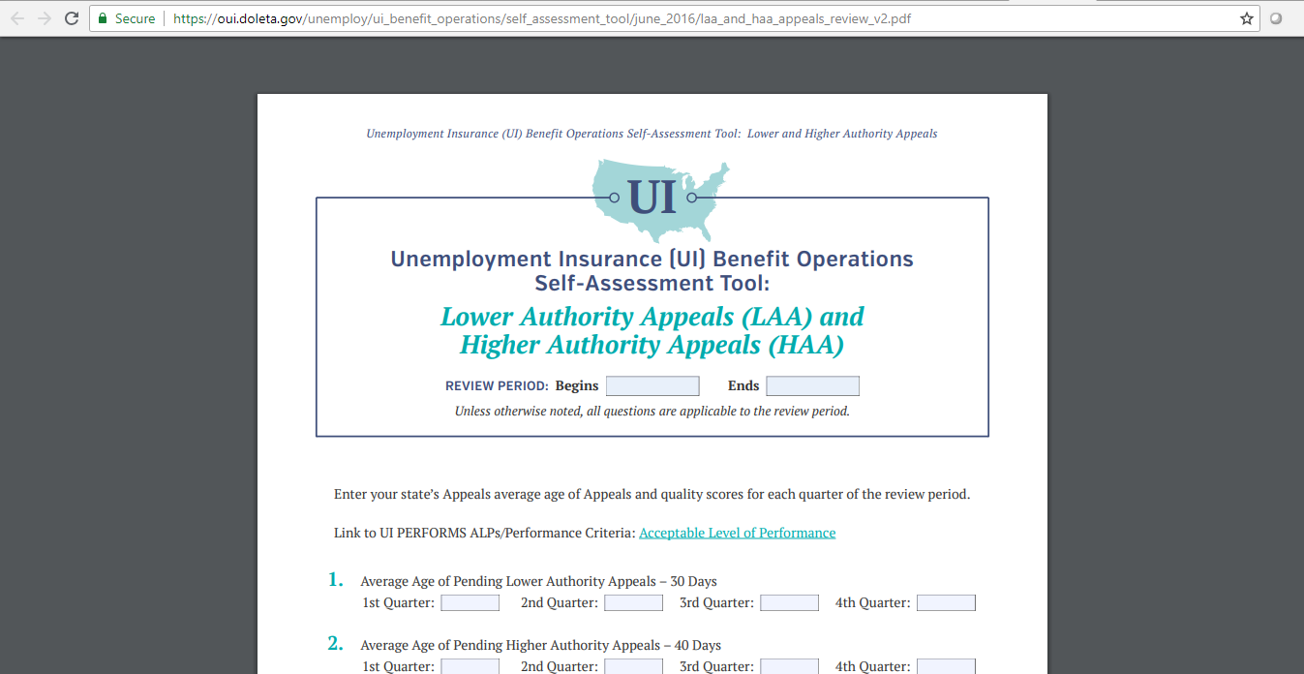
Self-Assessment Questions Appeals (53 Questions)

Slide 11
State Self-Assessments Submitted to Date
18 states have submitted one or more completed program or functional Self-Assessments
37 states still have ALL 15 program or functional areas to submit
Most states have submitted less than five completed Self-Assessments (KS-8, SD-6)
Only two states have submitted the Self-Assessment for Appeals (ME and MT)

Slide 12
Due Dates
The state should complete all 15 program or functional areas by March 30, 2019​. USDOL encourages states to submit responses as soon as they are completed.
All 15 Self-Assessment program or functional areas must be SUBMITTED to USDOL by April 15, 2019

Slide 13

QUESTIONS

Slide 14
Contact Information
\
Candace Edens
Chief, Federal and State Programs
Office of Unemployment Insurance
USDOL/ETA
202-693-3195
Edens.Candace@dol.gov

