Slide 1
National Association of Unemployment Insurance Professionals Annual Conference Annapolis, Maryland June 18, 2018
Tom Dewberry, Chief Judge
Denise Shaffer, Director of Quality Assurance
Maryland Office of Administrative Hearings
Evidence in Administrative Hearings

Slide 2
Why Are We Here and What is This Session About?
??

Slide 3
Practical Evidence
Learning Objectives
1. Be able to recognize situations that present unusual evidentiary questions.
2. Be able to create a record containing relevant, authenticated evidence
3. Be able to properly analyze the implications to the hearing process of situations that present unusual evidentiary questions or a non-traditional request to consider evidence.
4. Be able to rule confidently in situations involving unusual evidentiary questions.

Slide 4
The Basics
Evidence Must Be Probative
Reasonable and prudent individual commonly accepted in the conduct of their affairs.
Exclude:
Incompetent
Irrelevant
Immaterial
Unduly repetitious
Hearsay
Not excluded solely because hearsay

Slide 5
Expertise of the Agency
Agency or OAH may use its experience, technical competence, and specialized knowledge in the evaluation of evidence
Official Notice – Examples from MD OAH
HGN, OLS
Medical terms – from dictionary or DSM
MA and FSP Manuals
SSA Dictionary of Occupations and Exertional Levels
OAH bound by agency
Regulation
Prior adjudication
Declaratory ruling
Other settled, preexisting policy

Slide 6
Basis for Objections
Unreliable hearsay
Incompetent
Irrelevant
Immaterial
Unduly repetitious
Asked and answered

Slide 7
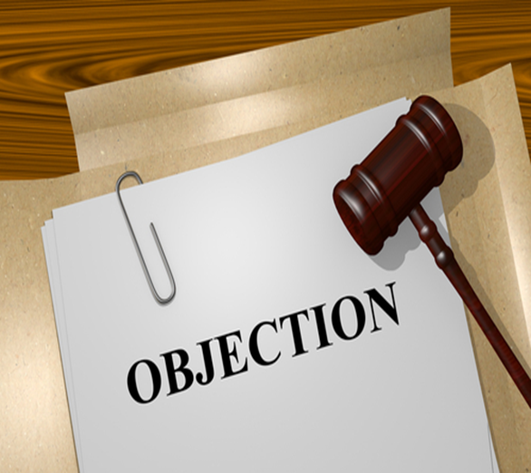
Explaining Rulings on Objections
Courts in various jurisdictions have commented that it is a good practice for trial courts to explain their rulings on objections. See, e.g., Citibank S. Dakota, N.A. v. Wood, 862 N.E.2d 576, 588 (Ohio App. 2006); Atkins v. Johnson, 342 S.W.2d 648, 650 (Tex. Civ. App. 1961);State v. Carter, 451 S.W.2d 340, 345 (Mo. 1970).
Such an explanation can provide guidance to the attorneys.
An attorney may be unaware of a judge’s view that certain evidence is inadmissible in a particular administrative hearing.
The attorney may continue to offer evidence that the judge views as not relevant until the judge explains his or her reasons for excluding the evidence in question.
Doing so helps provide a more complete record for a court to consider on judicial review.

Slide 8
Proffers
Section 10-213(a)(1) of the State Government Article requires each party in an administrative case to “offer all of the evidence that the party wishes to have made part of the record.”
Based on this provision, it is Maryland OAH practice that if a judge excludes evidence, the proponent of the evidence must be permitted to make a proffer.
Failure to make a proffer compromises the record and may preclude judicial review

Slide 9
Authentication in Administrative Proceedings
“[T]he act of proving that something (as a document) is true or genuine.” Sublet v. State, 442 Md. 632, 655 (2015).
Query: Is the evidence what its proponent claims it is?
If a piece of evidence is not properly authenticated, it is incompetent.

Slide 10
Authenticating Conventional Items
The author may authenticate.
A person familiar with author’s signature may authenticate
Reply letter doctrine: the document appears to be prompt response to another authenticated letter written to signatory.
Contents — information in the document is known (or, better yet, is known only) to the signatory.
Some documents may be self-authenticating (public records under seal; certified copies of public records).

Slide 11
Authenticating Photographs
Two distinct methods to authenticate photos (or video):
(1) witness testimony from firsthand knowledge that the video (or photo) fairly and accurately represents the scene or object it purports to depict as it existed at the relevant time; or
(2) the silent witness theory of admissibility, under which a video (or photo) speaks with its own probative effect.
Under the silent witness theory, the proponent must present evidence regarding the type of recording equipment, how the footage was focused, how reliable the images were, etc.

Slide 12
Authenticating Video
For purposes of authentication, video recordings are treated like photographs
Case Study: Washington v. State, 406 Md. 642 (2008)
Washington: improper authentication where footage from eight security cameras was distilled into a single video through undisclosed mechanisms.

Slide 13
Authenticating Electronic Communications
Challenges:
No conventional signature
Problems of fraud, hacking, unauthorized use
Opportunities for anonymity
General Considerations:
The burden of proof for authentication is a low one.
Authentication may be accomplished by direct or circumstantial evidence.
Authentication may be accomplished entirely by substantial evidence.

Slide 14
Authentication of Email
Printout of email bearing sender’s email address provides circumstantial evidence that message was transmitted by the person identified in the email address.
Successfully replying to the sender’s email address indicates that message was originally sent from that address.
Contents of email may authenticate email by showing details known to alleged sender.
Email address is not conclusive. Email message can be sent by person other than named sender. Person with unauthorized access to computer can send email message under owner’s name

Slide 15
Facebook
Case Study: Sublet v. State, 442 Md. 632 (2015)
Most case law is from criminal cases.
Printout of communications on Facebook among alleged victims of assault.
But witness denied that she had sent one of threatening messages – her “bf [the defendant] is a dead man walkn.” Witness claimed that others had access to her logon information and password.
No evidence refuted witness’s claim.
HELD: Communication was not authenticated.

Slide 16
Facebook and Sublet, continued
After defendant stabs his girlfriend, remorseful messages, purportedly from him, start to appear on her Facebook page.
Messages were written very shortly after the stabbing, when very few people would’ve known of it.
Victim testified that defendant started calling her to apologize at about the same time and that he later wrote her a letter of apology.
Messages were properly authenticated.

Slide 17
Twitter
Case Study: Sublet v. State, 442 Md. 632 (2015)
Police recovered the messages and tweets from mobile phones in defendant’s possession.
Messages reflected a conversation between two persons with two aliases or tags. One of the tags had the defendant’s photo next to it. Witnesses said that that tag belonged to the defendant.
Witness said that the defendant and another person, who was identified as the person who used the other tag, were planning the assault discussed in the messages.
Messages were adequately authenticated.

Slide 18
Text Messages
Case Study: Dickens v. State, 175 Md. App. 231 (2007)
No question that defendant killed his wife. Only question is premeditation.
Victim received threatening messages in days or months before she is killed.
Some of the messages were sent from defendant’s phone, which was found near the scene of the crime.
Although some messages could not be tracked to defendant’s phone, they contained information that only he would know.
Some messages were from “Doll/M,” which the court took to be a reference to Dial M for Murder.
Messages were properly authenticated.

Slide 19
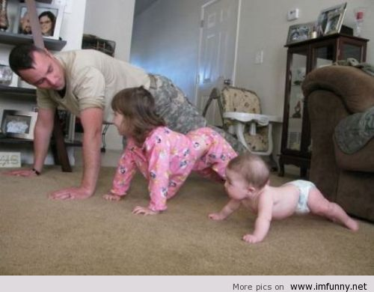
TRAINING SCENARIOS

Slide 20
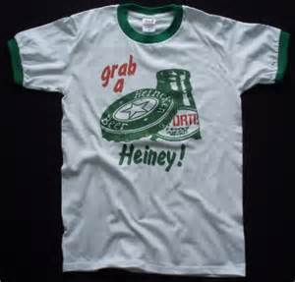
Scenario #1
You are conducting an unemployment hearing. Seventeen year old Billy Bourbon is appearing before you after being fired for coming to work with alcohol on his breath. Billy shows up wearing basketball shorts, a Bud Lite hat turned backwards and wearing a tee shirt that says “Grab a Heiney” and has a beer bottle on it. Can you consider Billy’s dress as evidence in the case? Why or why not?

Slide 21
Scenario #2
You are conducting an unemployment hearing. Justin Time, a government employee, is challenging a termination for cause for his 39th occasion of tardiness in the last year. The hearing is scheduled to begin at 9:00 am. It is now 9:15 am and the representative for the agency that took the discipline asks that you find Mr. Time in default for failing to appear. Before you can rule, Time rushes into the room, sits down, apologizes for being late and mumbles something about a flat tire. You deny the motion and begin the hearing. Can you consider Time’s tardiness as evidence in the hearing? Why or why not?

Slide 22
Scenario # 3
You are conducting disability hearings for the state. After a hearing you conclude that the appellant, Steven Hawking, is not disabled. In writing your decision you arrive at this conclusion, in part, because you observed that Mr. Hawking’s demeanor at the hearing was not consistent with the presence of any physical or mental impairment and that he tolerated the hearing very well. Will this demeanor based assessment withstand scrutiny? Why or why not?

Slide 23
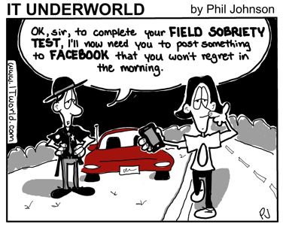
Scenario # 4
You have a motor vehicle license hearing docket. In your first case, the appellant, Mike Phelps, is trying to get his license back after it was revoked for multiple alcohol violations. The hearing begins and Mr. Phelps testifies that without a license he does not drive and that he really needs his driver’s license to go to church, make it to swimming practice and attend alcohol counseling. The hearing has to be continued because Phelps’s witness, an alcohol counselor, had an emergency and could not attend the hearing. You adjourn the hearing. It’s a nice day so you step outside for some fresh air before calling the next case. While outside, you see Phelps enter a car, get behind the wheel, and drive out of the parking lot. Can you consider Phelps’s conduct as evidence in his continued hearing? Why or why not?

Slide 24
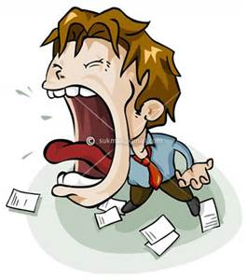
Scenario # 5
You are conducting unemployment hearings (again!) David Berkowitz, a crime scene investigator, is challenging his termination. You start the hearing and begin reading the charges which led to the termination, which begin: “We are proposing to discharge the employee due to his unacceptable behavior in the work place, the employee is consistently argumentative and paranoid.” At this point, Berkowitz jumps up and screams at you that the charges are untrue, agency management is just out to get him! Can you consider Berkowitz’s outburst as evidence in the case? Why or why not?

