Slide 1
Truth or Fiction? Finding Credibility in Lower Authority Unemployment Insurance Hearings
Katrina Gulstad • Chief Unemployment Law Judge
Sasha Mackin • Supervising Unemployment Law Judge
Seattle, Washington
June 21, 2017

Slide 2
Credibility

Slide 3
Truth or Fiction – credibility determinations in unemployment benefits hearings
Why do we care about credibility findings?
How do we make credibility findings?
How do we articulate credibility findings?

Slide 4
Why we care
UI Program – supposed to pay those eligible and not pay those ineligible.
Legitimacy of the decision – how did the hearing officer arrive at this decision? Is it arbitrary? Biased?
Is it mandatory in your state to make a credibility finding?

Slide 5
Pay the right people the right amount
From 4th quarter 2015 to 3rd quarter 2016, USDOL estimates the total improper payment amount to be a whopping $3,644,518,239.
That’s an average rate of 12.08% across all state programs.

Slide 6
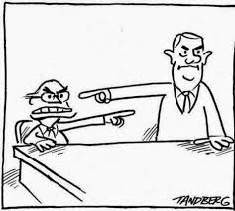
Legitimacy of the decision

Slide 7
Minnesota’s statutory requirement
Minnesota Statutes, section 268.105, subd. 1a:
When the credibility of a witness testifying in a hearing has a significant effect on the outcome of a decision, the unemployment law judge must set out the reason for crediting or discrediting that testimony.

Slide 8
How do we make credibility findings?
What process do you go through to assess credibility? What do you look at?

Slide 9
Elements of Credibility
Level of details
Consistency
Plausibility
Story make sense?
Self-serving
Corroboration
Body language
Tone of voice
Eye contact
Ability to recall facts
Opportunity to know the facts
Evasive
Nonresponsive
Answers that go to emotion and not fact
Hearsay

Slide 10
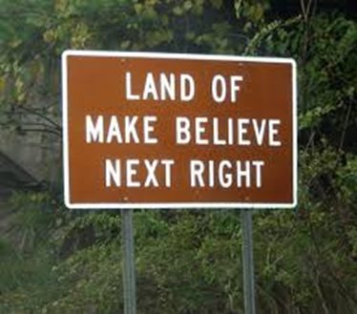
Barriers to assessing credibility
Partial truth-tellers
Equally plausible/implausible versions
Is there a statutory default? Burden of proof?
Interpreters
Absence of information
Time
Telephone hearings

Slide 12
Barriers to assessing credibility
Partial truth-tellers
Equally plausible/implausible versions
Is there a statutory default? Burden of proof?
Interpreters
Absence of information
Time
Telephone hearings
Implicit Bias
Prejudging the case based on fact finding

Slide 13
Migrant farm worker case
The migrant workers’ stories were inconsistent and in some cases, fabricated.
Vs.
The employer witness had detailed testimony, claimed to have detailed business records, emphatic, better recall, consistent within each hearing, more sophisticated witness; knew the law.

Slide 14
How to articulate credibility
Avoid canned language.
Use examples from the hearing.
Be respectful in your tone – don’t resort to sarcasm or snark.
Write down what you’re thinking as you decide which version of events you conclude is true.

Slide 15
Written credibility findings
Okay:
The findings of fact are based on the employer's witnesses' testimony, because it was a more detailed and specific version of events.

Slide 16
Written credibility findings
Better:
The findings of fact are based on the testimony of the employer's witnesses which was detailed and specific. Smith's assertion that she was unfairly targeted is implausible; an employee who is specifically targeted for discharge is unlikely to be allowed to work for over a year after repeatedly violating a known policy. Also, Smith's initial statements to the Department, that she did not know why she was discharged, were disingenuous. It is not believable that an employee who repeatedly violates a policy after a written warning would have no inkling of the reasons for her discharge.

Slide 17
Written credibility findings
Okay:
The findings of fact are based on the employer's witnesses' testimony, because it was a more credible and straightforward version of events.

Slide 18
Better:
To the extent the parties disagreed, the findings of fact are based on the employer's witnesses' testimony, which was more credible because it was straightforward and more reasonable under the circumstances. Smith's testimony was, at times, implausible and unreasonable under the circumstances. Smith testified that on occasions she accessed Facebook, she was entitled to take breaks and to do what she pleased during her breaks. Smith clocked in at 7:28 a.m. on March 22, and was active on Facebook at 7:43 a.m., 7:47 a.m., 8:52 a.m., and 8:57 a.m. Smith claimed that she was on break at those times. It is not believable that Smith really thought that it was reasonable to take a break 13 minutes after the start of her shift, and then to take another break just over an hour later. Smith was either accessing Facebook outside of her permissible break time, or she was taking unreasonable and excessive breaks.

Slide 19
Written Credibility Findings
Okay:
Smith was more credible than the employer because he provided a more logical version of events.

Slide 20
Written credibility findings
Better:
Smith was more credible than the employer’s witness because he offered a more logical chain of events that was corroborated by written submissions. Smith was an eyewitness while the employer’s witness provided only hearsay testimony. The employer’s witness testified to conclusions and not detail. Smith recalled the facts easily and admitted to some actions that did not paint him in the best light.

Slide 21
Any questions?

